Slide 1

Homework
use * and printf() to print your birthday

Slide 2
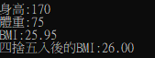
Homework
Use scanf to get height(cm) and weight(kg)，compute BMI = weight (kg) / height²(m²), rounding it to the nearest whole number.
E.g.：
Note : 1.you can not use if
2.output need to be floating point to the second decimal place

